Slide 1



Northrop Grumman
ME476C Senior Capstone Design
Preliminary

Slide 2
Project description
Through working with Northrop Grumman as the client, the team is set with designing a latching system for a door used on many of the company's rockets. This door provides an entrance to feed conditioned air through.
The team's objective is to solve an issue with the heritage design where its latching system was letting too much air escape due to the pressure differential during the rocket's flight.
This leakage of air could lead to a potential failure of the rocket.
If the team's design is successful, it has the potential to be implemented in a select number of Northrop's vehicles and would eliminate the risks involved with leaking air.

Slide 3
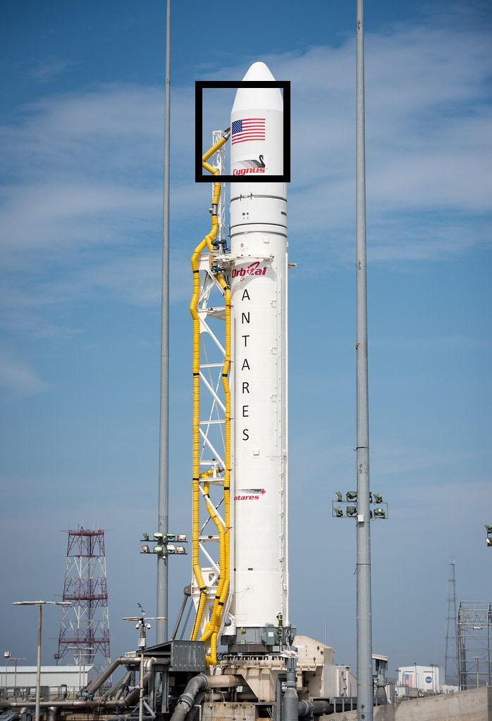
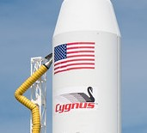
Antares Door
Figure 1: Antares rocket at launch
Figure 2: Door location

Slide 4
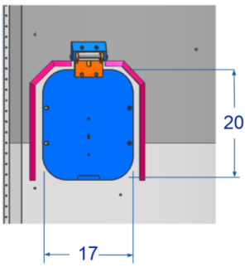
Background and current design
All background information has been provided through the team's contact at Northrop Grumman and through Northrop Grumman's website.
Currently, the design uses a hinged door that latches to the fairing using Velcro.
The door slams shut during launch using the force of a torsion spring at the hinge, as the air conditioning tube gets pulled away from the aircraft.
In some tests, the door has slammed upward against the fairing, potentially causing damage to the door or aircraft during launch.

Slide 5
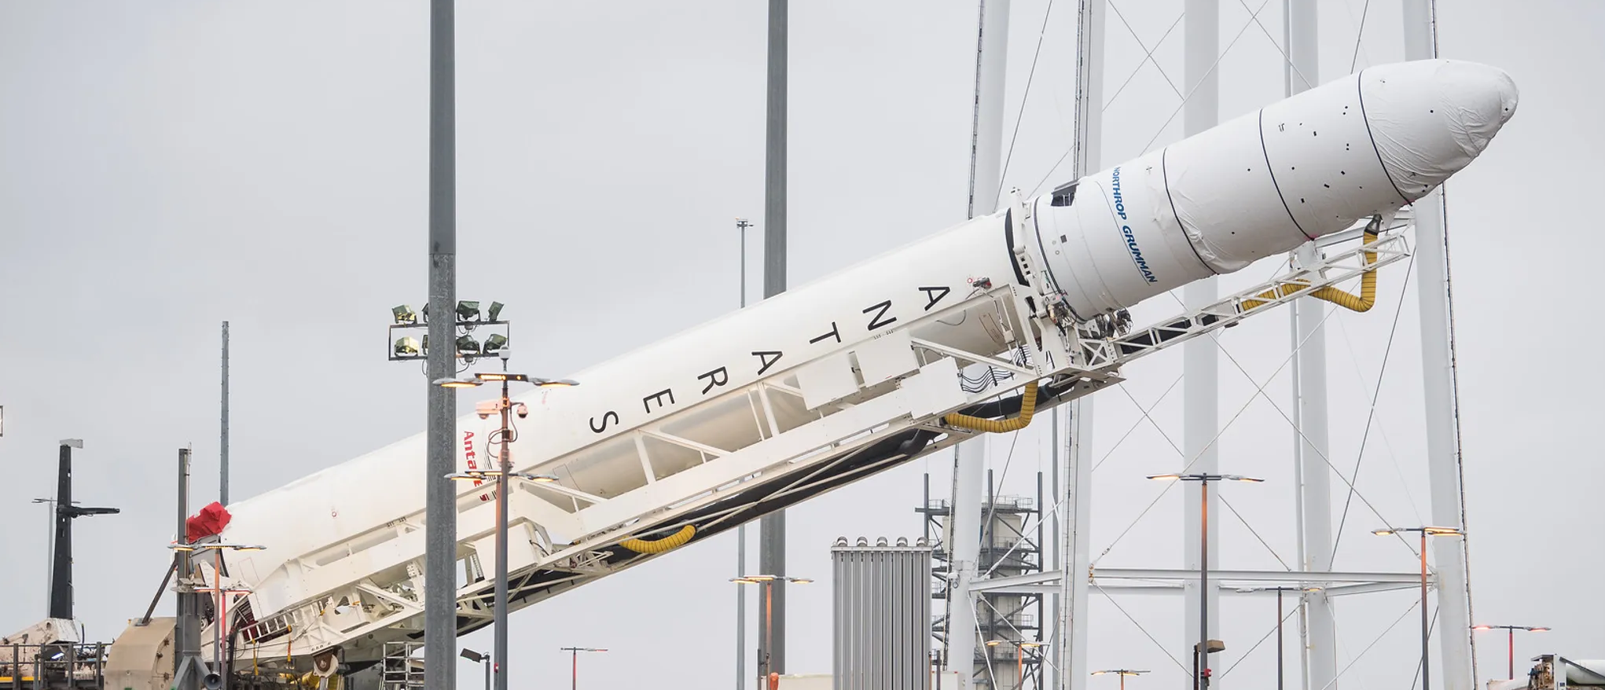
Current Design continued
The current design does not resist the pressure differential enough, causing air pressure from the interior payload to force open the door to extinguish internal pressure.
This dramatic pressure increase inside the aircraft runs the risk of mission failure and is the primary concern that must be addressed in the teams' design.
The team is researching doors, hinges, and latching mechanisms used in everyday applications that may help with engineering a design that will be used on this rocket.

Slide 6
Customer Requirements
Ease/Safety Of Installation
  Installation must be safe and manageable without the use of uncommon, specialized tooling.
Scalable
  Design must be able to be scaled for use on various sized Northrop Grumman vehicles.
Reopenable
  Door must be able to easily open without specialized tooling in case of accidental closure prior to launch.
Withstand Pressure Differential
  Design must be able to withstand pressure differential to prevent opening during flight.

Slide 7
Customer Requirements
No Contaminates
  Materials must not generate any contaminates such as shavings, sparks, dust, off gasing, foreign object debris, etc.
Not Based on Gravity
  Design must not rely solely on gravity or acceleration of vehicle to close during launch.
Door Closes On Launch
  Design must automatically close upon launch of the vehicle when the ECS nozzle is removed.
No Interference With Nearby Systems
  Design must not interfere with nearby satellite systems or operation of vehicle fairings.

Slide 8
Customer Requirements
Professionalism
  Team must provide a high standard of professional work and communication.
Minimum Effect on Aerodynamics
  Design must be externally flat to prevent aerodynamic changes to vehicle.
Electrostatic Discharge Safe
  Design materials must not cause sudden electrostatic discharge to protect sensitive electronic circuits nearby.
Stretch Goal: Door Status Indicator
  Design remotely indicates status of door as open or closed.

Slide 9
Customer requirements
Table 1: Rated customer requirements.
# | Customer Requirement | Rating
1 | Ease/safety of installation | 7
2 | Scalable | 8
3 | Reopenable | 4
4 | Withstand Pressure Differential | 10
5 | No contaminates | 8
6 | Does not use gravity or acceleration | 6
7 | Activates on launch | 10
8 | Does not interfere with nearby systems | 9
9 | Professionalism | 5
10 | Does not influence aerodynamics | 9
11 | ESD safe | 7
12 | Indicates open/closed status | 1
From discussion, the requirements were rated on a 1-10 scale based on level of importance to the final design.
  Priority:
  Pressure differential
  Activates on launch characteristics
  No interference with nearby systems
  Nice to have:
  Indicate Open/Closed status electronically and accurately during flight testing.

Slide 10
Engineering Requirements
Safety Factor
  The metallic hardware shall meet a minimum safety factor of 1.6 to yield and 2.0 to ultimate.
  The plastic or composite materials shall meet a minimum safety factor of 2.0 to ultimate and 2.3 for buckling.
Vibrations
  The design must withstand a vibration test of 73Gs and loads in its closed state.
Pressure
  The design and hardware must withstand a pressure differential of 7.5 psi once in flight.
Budget
  The team must not exceed a budget of $5,000.

Slide 11

Engineering Requirements
Dimensions
  The maximum inlet area cannot exceed 203 ${in}^{2}$
Weight
  The door design is to not overcome a combined mass of 5 lbs.
Crush Rating
  The crush rating of the door is limited to 810 psi.
The engineering requirements are mapped out by applying units to the important customer requirements

Slide 12
References
“Antares Rocket,” Northrop Grumman. [Online]. Available: https://www.northropgrumman.com/space/antares-rocket/. [Accessed: 19-Sep-2020].

